Slide 1

NDMA C-UAS Operators
CMS

Slide 2

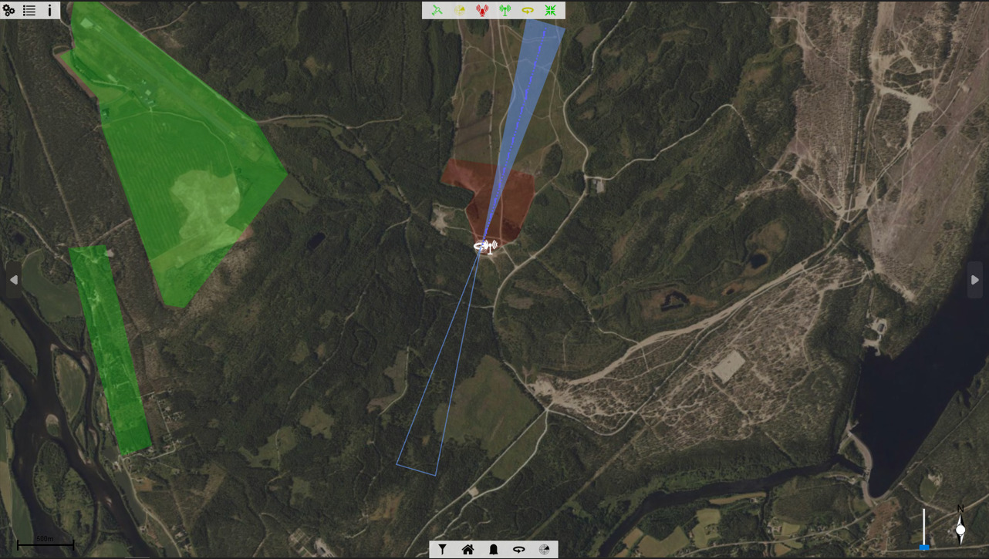
CMS Operation - Information
Info Bar
System Bar
Mission Bar
Notes:
Bottom right is for map orientation
The slider allows for the maps to be tilited in 3D for viewing targets in heights and direction.

Slide 3
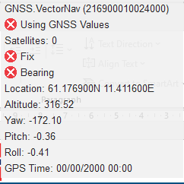
CMS Operation – Information Bar - GNSS
Displays the status of the GPS being received by the container.
Yaw is displayed as +/- 180.

Slide 4
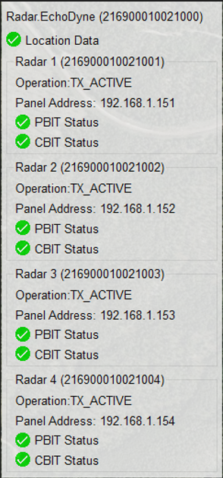
CMS Operation – Information Bar - Radars
Shows connection status of the Radars

Slide 5
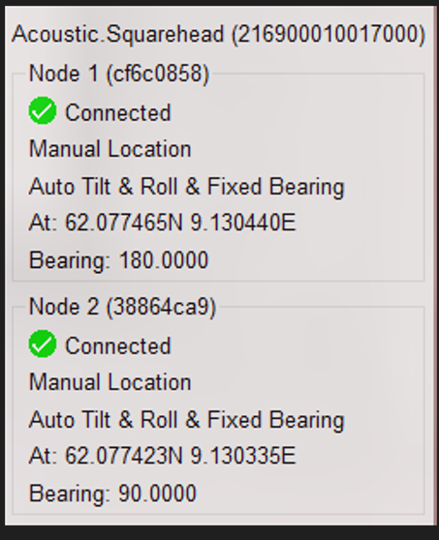
CMS Operation – Information Bar - Squarehead
Displays the status of the number of nodes connected to the system.
Therefore the user can verify the system is operating as expected.
Square head nodes should be in this address range to be detected:
10.10.192.2 to 10.10.192.255

Slide 6



CMS Operation – Information Bar
Shows that the Metis Module is loaded and operating.
Shows that the Platform Module is loaded and operating.
Shows that the CMS System Module is loaded and operating.

Slide 7
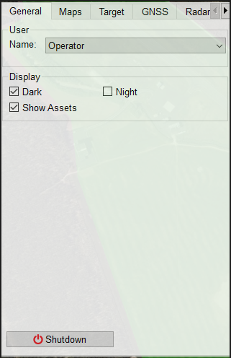
CMS Operation – Settings Menus - General
User:
Allow Elevation of user types to unlock further system settings
Display:
Dark: Dims the map view
Night: Provide better view of the CMS if utilised in the dark.
Show Assets:
Switches on/off the viewing of assets in the CMS.

Slide 8
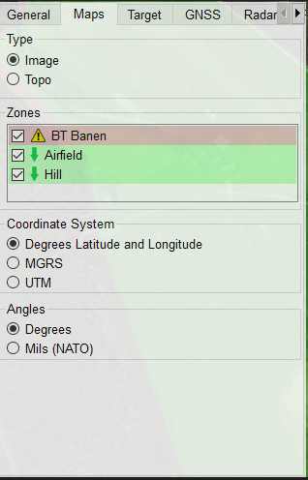
CMS Operation – Settings Menus - Maps
Type:
Allows user to toggle between available map types
Zones:
Allows created zones to be hidden.
Coordinate System:
Allows user to switch between coordinate types
Angles:
Allows the user to switch between values.

Slide 9
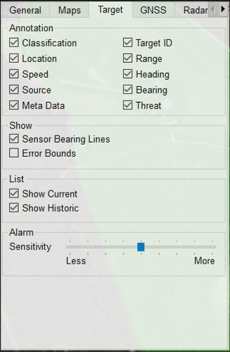
CMS Operation – Settings Menus - Target
Annotation | Meaning
Classification | System will display the type of target it believes it is tracking
Location | Provides the Geolocation of the target
Speed | Speed in M/s
Source | Which sensor or combination has detected
Meta Data | Data displayed is dependant on the sensors
Target ID | Internally generated unique system ID
Range | Range of the Target displayed in M
Heading | The direction the Target is heading
Bearing | Bearing in relation platform location
Threat | Internally calculated value. XXX-XXX First Value denotes certainty of target present Second Value denotes the threat level. 0-100
Show | Meaning
Sensor Bearing Line | System will display a bearing line to targets Only applicable to Metis and Squarehead
Error Bounds | Will show predicted error of the Target
List | Meaning
Show Current | Current Live target will be shown in the list
Show Historic | This will show historic tracks. These will be removed from the list after 10 minutes.

Slide 10
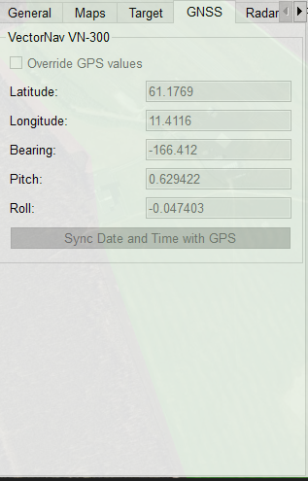
CMS Operation – Settings Menus - GNSS
Allows Supervisor level users to override to system internal GPS and provide a fixed offset and position.

Slide 11
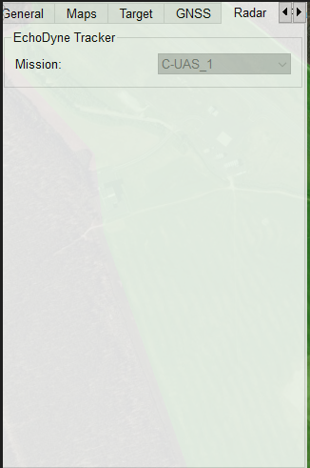
CMS Operation – Settings Menus - Radar
Allows Supervisor level users to alter the mission settings of the Radar.
As standard this is set to C-UAS_1

Slide 12
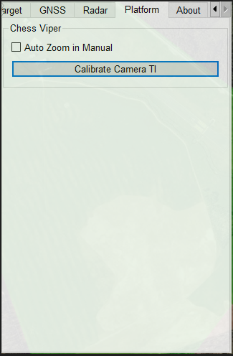
CMS Operation – Settings Menus - Platform
Settings relating to the control of the Chess EOD.
Auto Zoom in Manual – The system will change zoom level based on where you select on the CMS Map to view taking into account the relevant distance.
Calibrate TI Camera – This performs the same operation as the VMS “Calibrate”
Notes:
Auto Zoom in Manual – The system will change zoom level based on where you select on the CMS Map to view taking into account the relevant distance.
Use HD Camera – Selects which camera to use when in Target Acquire modes.

Slide 13
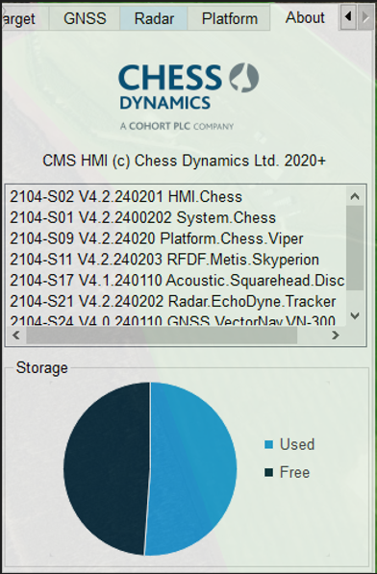
CMS Operation – Settings Menus - About
Menu displays information relating to the CMS.
If reporting Issues to Chess, then this information would be useful to include.

Slide 14

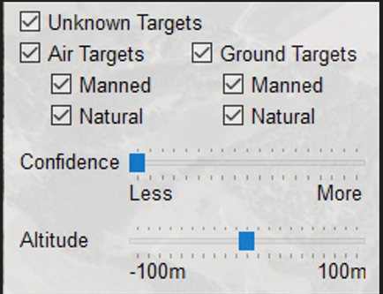
CMS Operation – Mission Bar – Target Filters
Adjustments can be made to the confidence levels to filter Targets.
Less Confidence, will display more targets.
The higher the setting, the more the system believes there to be a viable Target.
Annotation | Meaning
Unknown Targets | Will filter out targets that are not classified by the system
Air Targets | Target needs to be classified as a valid air Target
AT Manned | This would filter out Aircraft from ADSB etc.
AT Natural | All other Air Targets
Ground Targets | Target needs to be classified as a Ground item. Eg. Ground Controller.
GT Manned | Vehicles etc.
GT Natural | Other Ground Targets
Altitude adjustment
Will filter out Targets below above the set threshold.
Notes:
No decision made based on height of Targets

Slide 15
CMS Operation – Mission Bar – Home
Home Button:
This will reset the CMS display back to a standard set point.
Home location will be central, North Aligned and 0 tilt angle.
Useful feature if a user gets lost navigating the mapping.

Slide 16
CMS Operation – Mission Bar – Alarm
Alarm toggle:
This will disable Alarms and notifications. When re-enabled, it will then notify of missed Alarms.
This will time out and automatically re-enable a pre-defined time.

Slide 17
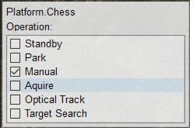
CMS Operation – Mission Bar – EOD Control
Annotation | Meaning
Standby | Will put the system to Standby
Park | Will park the EOD at its internal park position
Manual | The system can be manually moved to a point on the map or a target by selecting on the CMS
Acquire | Transient mode where the system is looking for targets that could be tracked optically
Optical Track | Will set the VMS to track mode if there is a target of interest which the tracker has identified in the FOV.
Target Search | System will slew to targets based on internally calculated threat levels.

Slide 18

CMS Operation – Mission Bar – Radar
Allows the users to Enable/Disable Radar Transmissions.

Slide 19



CMS Operation – Asset Icons
Acoustic Sensor
EOD Location
Metis RDFD Sensor
Notes:
Pressing home

Slide 20
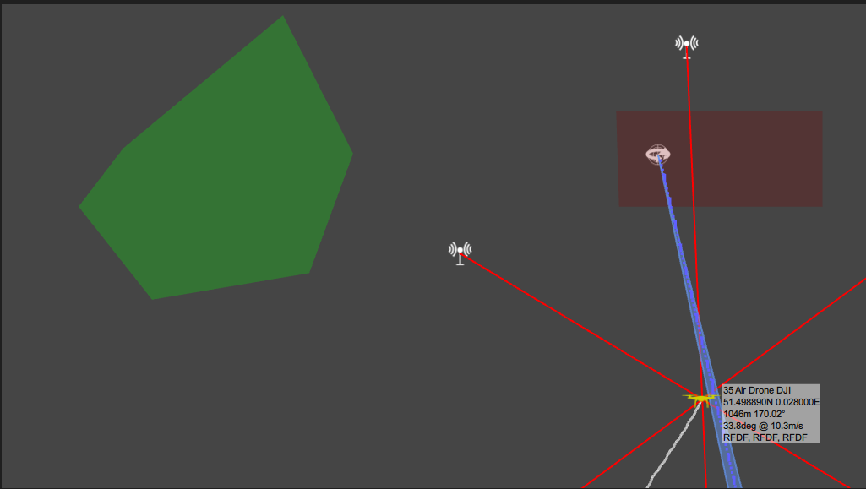
CMS Operation – Zones
Two types of zones can be created.
Alarm Zone:
This will show as a Red Area on the CMS
Threat Adjustment Zone:
This will show as a Green area on the CMS

Slide 21
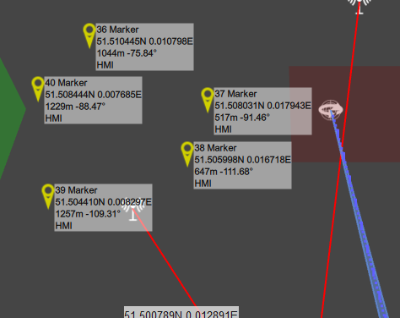
CMS Operation – Zones
Creating Zones is a Supervisor level operation in the CMS
Add Markers around the area you wish to make the zone.

Slide 22
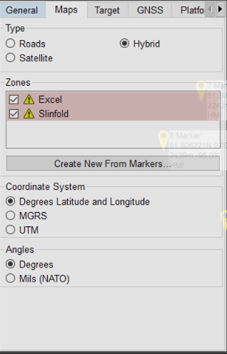
CMS Operation – Zones
In the Maps Tab in the setting, when at supervisor level, an option will be displayed to:
“Create New from Markers”

Slide 23
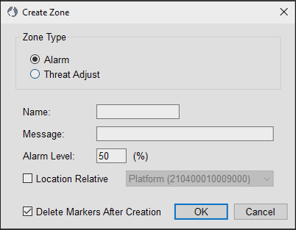
CMS Operation – Zones
Creating an Alarm Zone:
Name:
This can be anything
Message:
This is the message that is displayed in a pop up window when the Alarm is Trigged.
Alarm Level:
This is the bottom threat level where the Alarm will trigger.
0 Low threat to 100 High threat.
Location Relative:
If unselected it will be Geo Located.
If selected, this will lock the alarm zone to the asset.

Slide 24
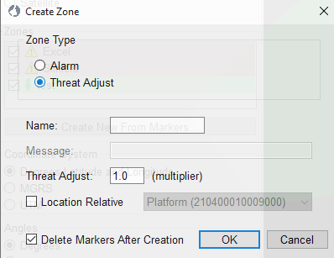
CMS Operation – Zones
Creating a Threat Adjust Zone:
Name: This can be any text.
Threat Adjust:
This will multiply the threat level of a target.
So can be utilised to increase or decrease the sensitivity of an area.
Location Relative:
If unselected it will be Geo Located.
If selected, this will lock the alarm zone to the asset.

Slide 25
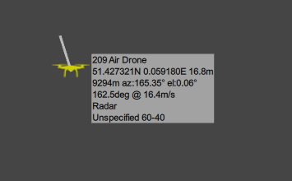
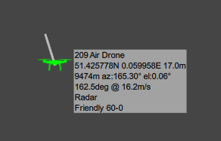
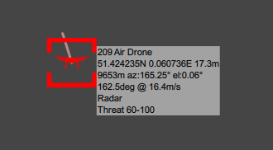

CMS Operation – Target Engagement
Targets seen on the CMS can be Marked as Friendly and the Icon will turn Green.
The Calculated Threat level will be automatically set to 0
If you set a Target to Engage, the calculated threat level will be automatically set to 100

Slide 26
Software application
Questions?

Slide 27
CMS Operation - Settings
Slide TEMPLATE
Notes:
The GPS data is also used to calculate a target position when the laser is fired, using the vehicle position and the range returned by the laser. This is displayed in the top right of the main sensor display, as well as the top right of the full screen display.
Laser will be covered in a later module.
Admin Menus will be covered in a later module.

